Slide 1
3D Pose estimation of needle holder
Robotics Vision SS2024
BY-
Krithika Premkumar(ESE)
Akhilesh K(ESE)

Slide 2
OUTLINE
INTRODUCTION
PROBLEM STATEMENT
METHODOLOGY OVERVIEW
DETAILED METHODOLOGY
RESULTS
CHALLENGES
FUTURE WORK

Slide 3
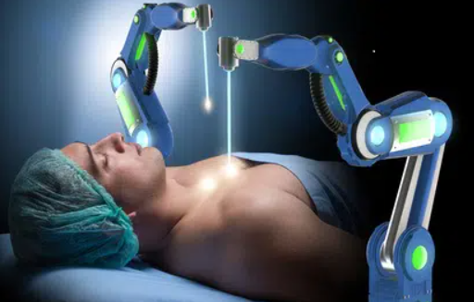
INTRODUCTION
Target Localization: Accurately tracking the needle holder tip allows surgeons to precisely locate and target specific anatomical structures or points of interest within the patient's body.
Instrument Guidance: Provides real-time feedback on the position and orientation of surgical instruments, ensuring they are correctly positioned relative to the surgical target.
Accuracy : 3D tracking ensures precise navigation of surgical instruments to target locations, enabling autonomous systems to execute tasks with a higher level of accuracy than manual operations alone.
Source:https://www.rsipvision.com/robots-in-medical-applications/

Slide 4
PROBLEM STATEMENT BREAKDOWN
RECTIFICATION OF IMAGES FROM STEREO VISION
DISPARITY MAP
3D RECONSTRUCTION
COLOURED OBJECT DETECTION
2D->3D COORDINATE FORMATION
COORDINATE TRANSFORMATION

Slide 5
DETAILED METHODOLOGY

Slide 6
RECTIFICATION OF IMAGES
LEFT CAMERA AND RIGHT CAMERA MATRIX CONSTRUCTION
cameraParameters Object : Camera_Parameter.txt file is used to get information about intrinsic and extrinsic parameters.
rotationVectorToMatrix: Rotation vector in Camera_Parameter.txt is in Rodriguez notation. This must be converted to Rotation Matrix using Rodriguez formula.
stereoParameters Object: Construct stereo parameters object with the rotation matrix and translation vector
rectifyStereoImages : Rectify the images with the stereoParameter object constructed.

Slide 7
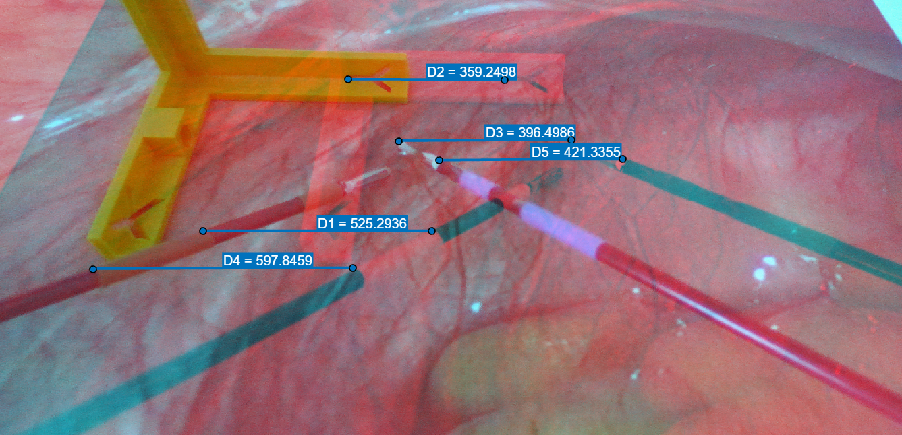
STEREO ANAGLYPH
Use of stereoAnaglyph to verify the rectification process and measure the disparity.
Use of ImageViewer App to measure the distances between the points in the left and right images. The values shown are the disparities between the points in left and right images.
Points farther from camera have less disparity compared to closer ones.

Slide 8
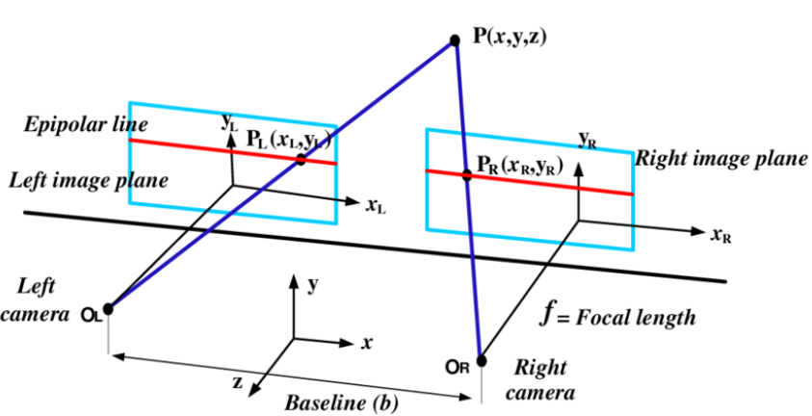
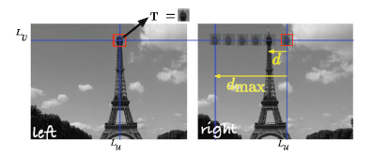
DISPARITY MAP
Since the previous step, we have reduced our problem to a 1D problem.
Using Epipolar geometry, the disparity map can be constructed.
istereo() from peter corke Machine Vision tool box
Disparity range input can be given by measuring using Measure distance illustrated in previous slide
https://www.researchgate.net/figure/Figure-2-The-epipolar-geometry-of-stereoscopic-vision_fig2_331960044
Source: Peter Corke,Robotics Vision and Control

Slide 9
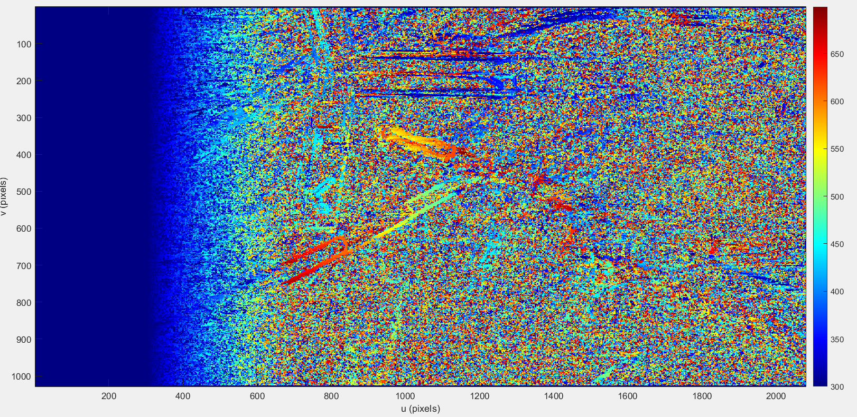
DISPARITY MAP
The generated Disparity Map shows red for objects closer to the camera.
As the distance from the camera increases, the disparity is shown with lighter colours showing a reduction in it.
With this, a depth map can be derived.

Slide 10
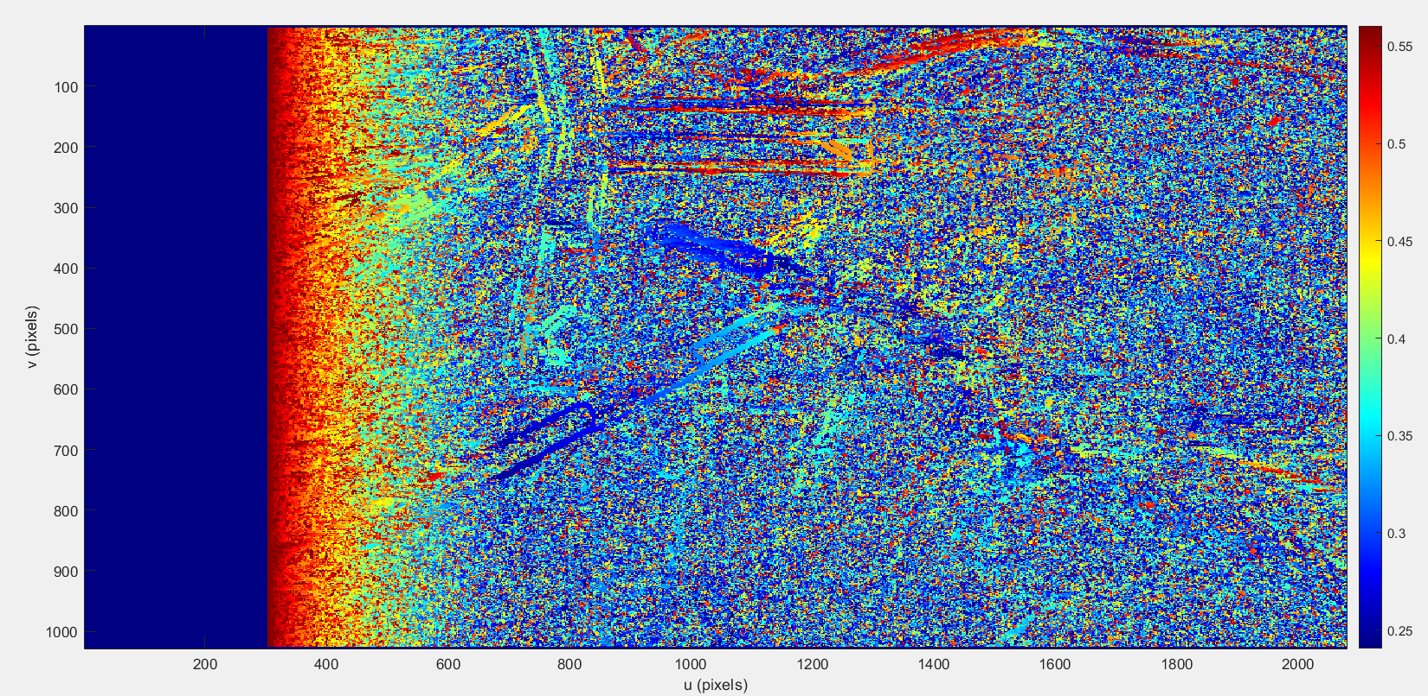
DEPTH MAP
The gradient in colour for the needle holder can be seen.
For the needle holder the colour moves from dark blue to light blue indicating the increase in distance from the camera

Slide 11
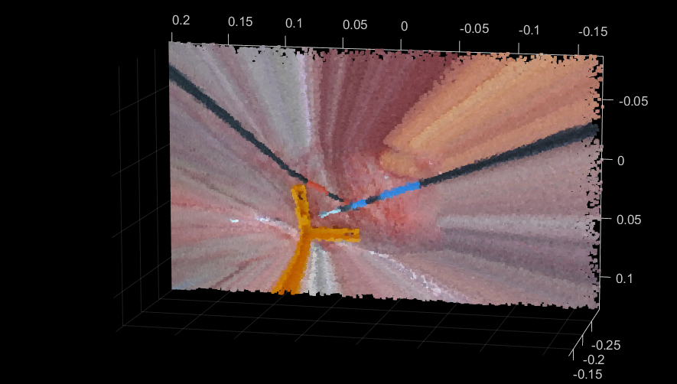
3D RECONSTRUCTION
With the disparity calculated, the 3D scene is reconstructed using reconstructScene with the disparity and the reprojection matrix given as input.
With this the point cloud is constructed as shown in the figure. This point cloud contains the 3D world points of the corresponding pixel in the 2D image.

Slide 12
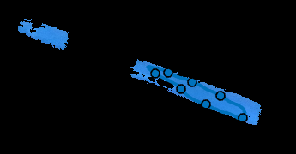
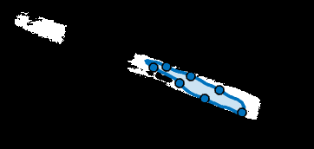
COLOURED OBJECT DETECTION
Colour segmentation is done to classify pixels based on their colour for object detection.
Colour thresholder App in MATLAB is used to select the colour to be segmented. We have used the L* a*b* chromaticity plane and the colour of interest(blue in this case) was selected by freehand selection.
The mask generated was then exported as a function.

Slide 13
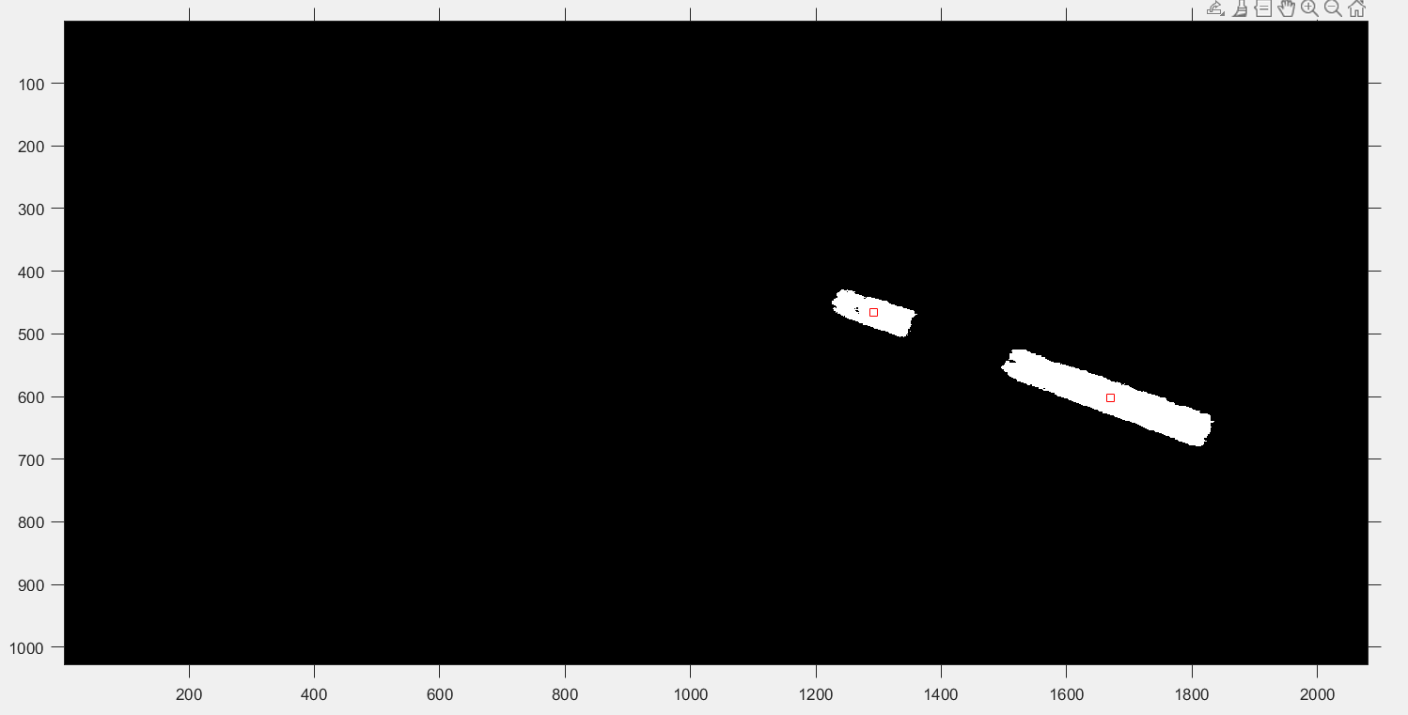
CENTROID CALCULATION
In order to detect the approximate middle point of the object, centroid calculation technique is useful.
To avoid multiple centroid calculation due to some stray pixels, a threshold was applied for the minimum number of pixels to be considered for centroid calculation using bwareaopen.

Slide 14
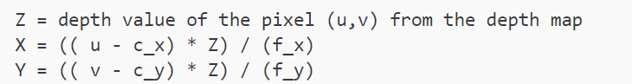
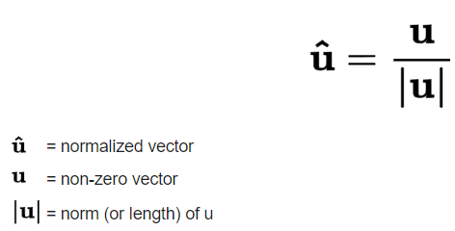
OBTAINING 3D POINT AND DIRECTION VECTOR
The 3D points of the two centroids identified are calculated using the formula in the Stereo labs website.
Direction Vector from the second tape to the first tape is computed.
Magnitude of the distance from one of the centroids to the tip is calculated based on the known dimensions.
Midpoint of tape farther from tip(pt1):0.085m
Midpoint of tape closer to tip(pt2): 0.047m
The final point is calculated by
Pt1+ 0.085*direction vector
Source:https://support.stereolabs.com/hc/en-us/articles/4554115218711-How-can-I-convert-3D-world-coordinates-to-2D-image-coordinates-and-viceversa

Slide 15
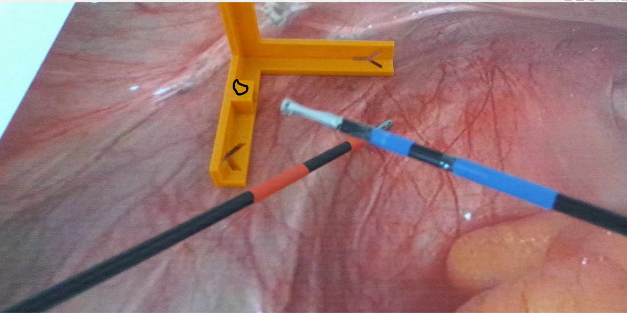
RESULTS
The point is then projected back to 2D to identify the tip.
The tiny green symbol is highlighted with a black circle. Although in the same direction as the rod, the location doesn’t seem to be as expected.
In order to identify the tip correctly, segmentation technique was employed again to classify the tip colour and identify the tip in the image.

Slide 16
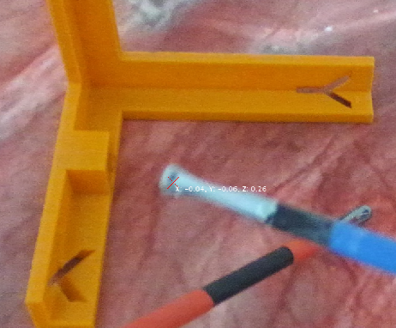
RESULTS
The identified tip is then seen in the image along with the coordinates of the tip with respect to Camera 1.
The next step is to shift the coordinate system wrt the yellow marker identified. Using colour segmentation technique the yellow marker is identified and the centroid is computed.
In this picture:
X= -0.04
Y= -0.06
Z = 0.26

Slide 17
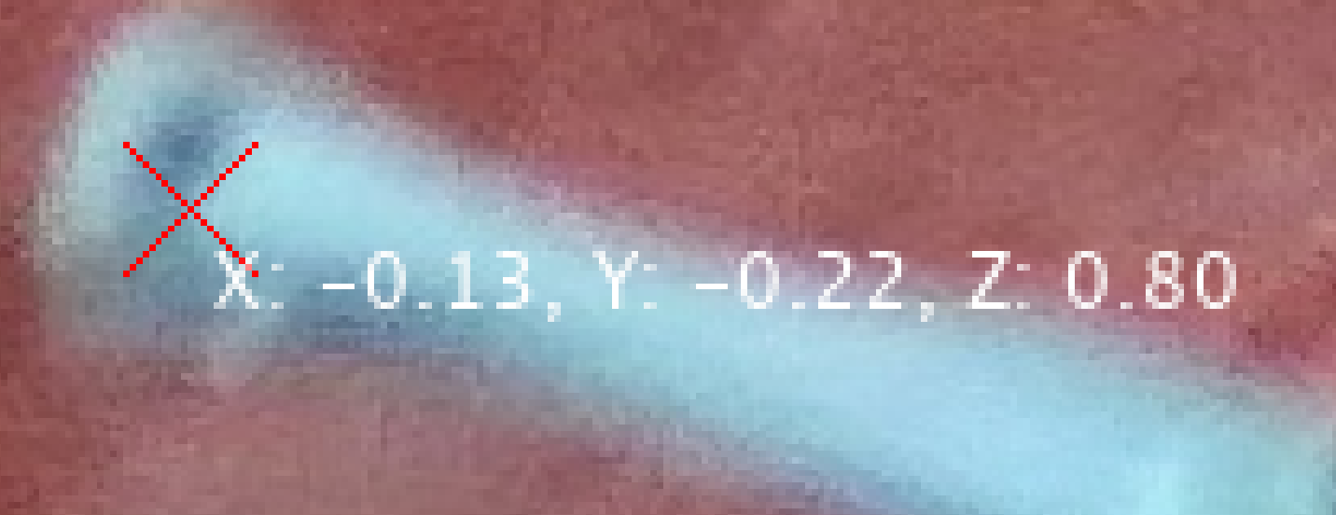
COORDINATE TRANSFORMATION
Homogeneous matrix construction using the translation vector information
Multiplication of the vector in Camera1 coordinate system with the homogeneous matrix to obtain the tip coordinates wrt yellow marker
New coordinates observed
X’=-0.13
Y’= -0.22
Z’ = 0.8

Slide 18
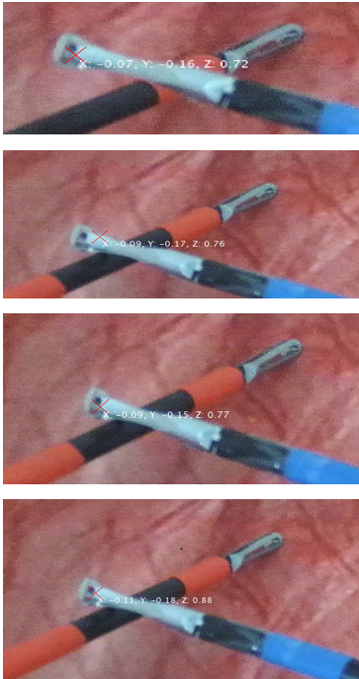
RESULTS
The trajectory of the needle holder tip has been tracked and the 3D World coordinates keeping the yellow marker as origin has been annotated.

Slide 19
CHALLENGES
Back projection of the identified point based on the dimensions was aligned along the position of the rod but not to the exact tip
Rotation matrix is important to completely define the 3D pose of the rod since movement to a new coordinate system can mean translation and also rotation.

Slide 20
QUESTIONS?

Slide 21
THANK YOU

